Slide 1

Event Scheduler Console Application
A Simple Command-Line Tool for Managing Events

Slide 2
Brief Overview :
Purpose:
Efficiently manage events using a simple command-line tool.
Need:
Simplify event organization for individuals and organizations.
Benefits:
Streamlines event creation, search, deletion, and display.
Intuitive and user-friendly interface.
Target Users:
ndividuals and organizations seeking lightweight event management.

Slide 3
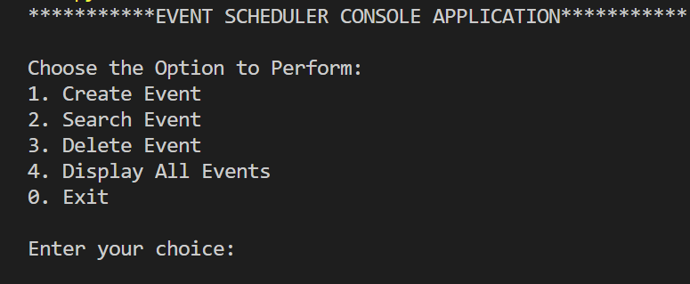
Event Scheduler Console Application
Description:
The Event Scheduler Console Application is a simple command-line tool designed to help you manage events efficiently. It allows you to create, search, delete, and display events using a text-based interface.

Slide 4
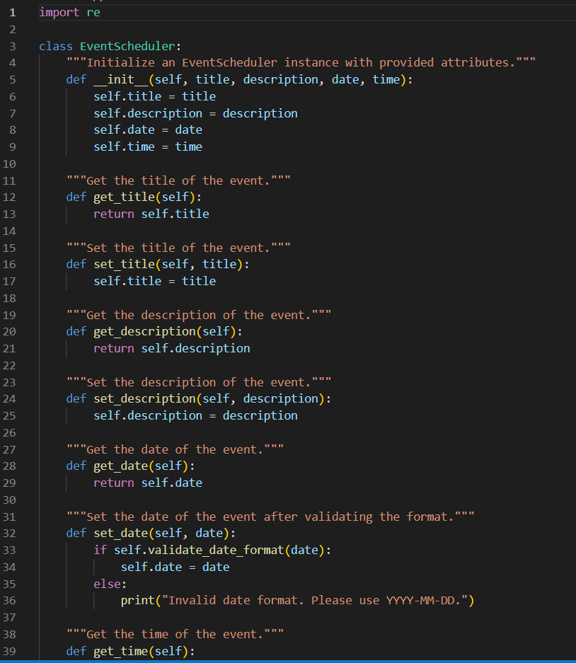
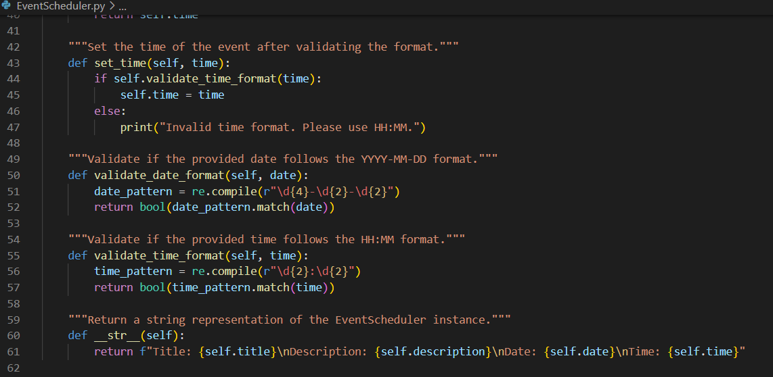
the structure of the code
EventScheduler:
Manages individual events, handling attributes, validation, and formatting.

Slide 5
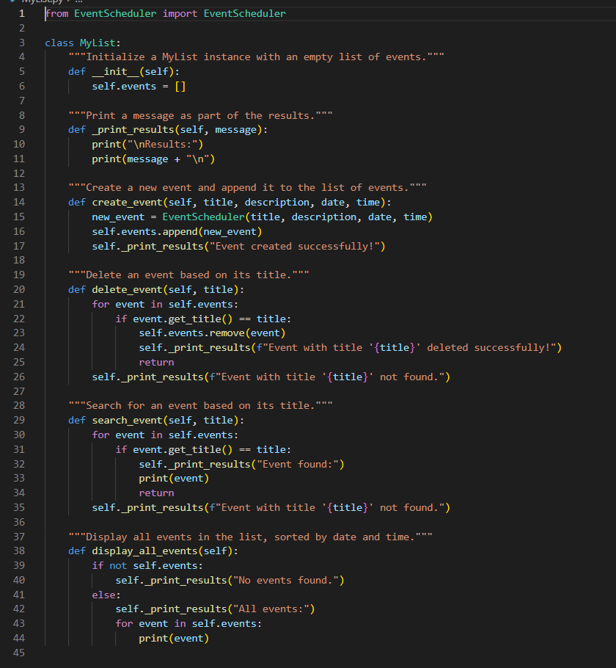
the structure of the code(Cont…..)
MyList:
Manages a list of events, providing functions for event manipulation.

Slide 6
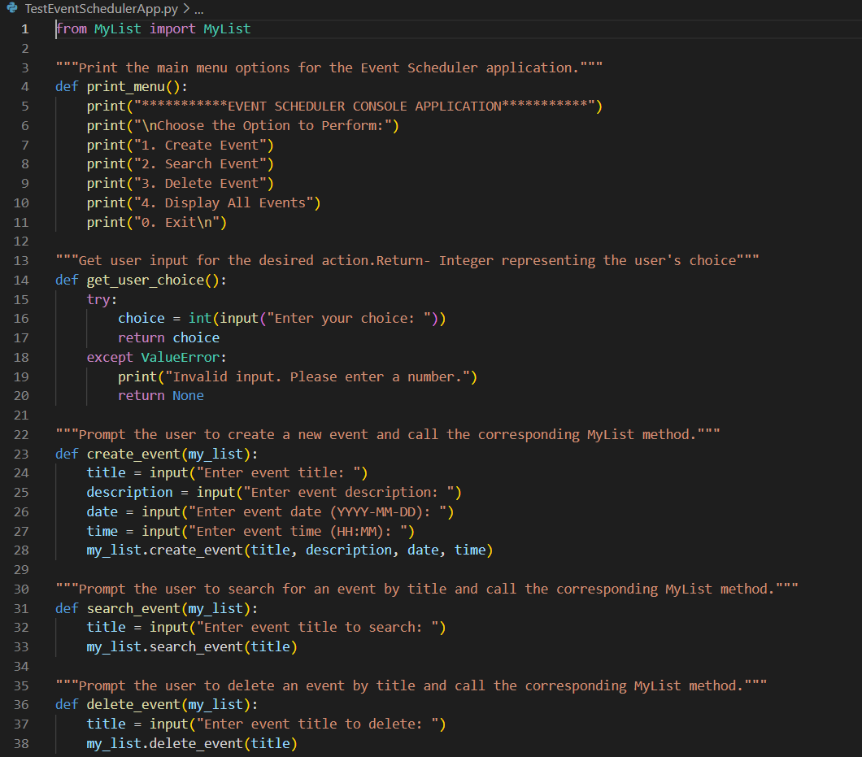
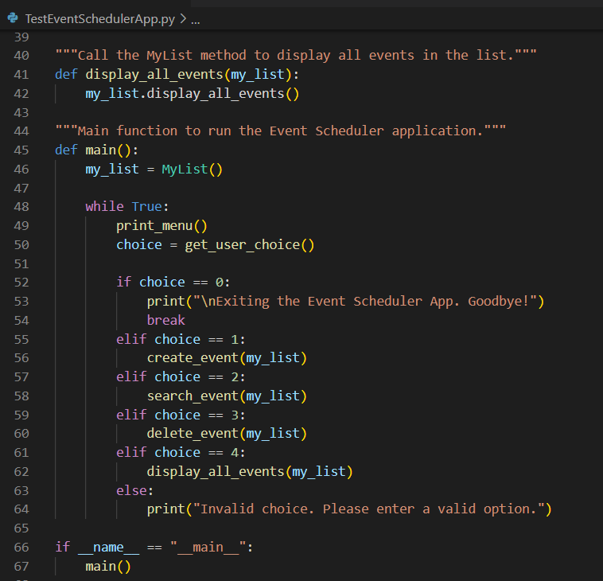
the structure of the code(Cont…..)
TestEventSchedulerApp:
Serves as the main application logic, displaying a menu and calling corresponding functions to interact with the user.

Slide 7
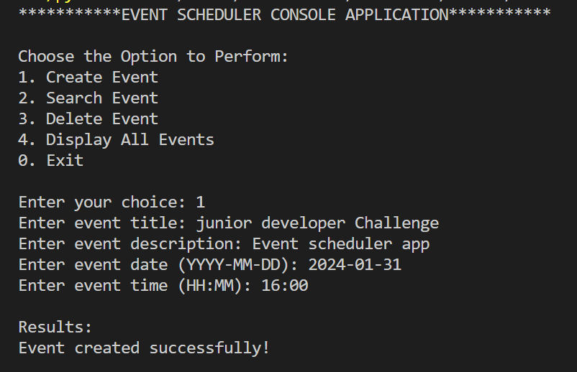
Usage and key features:
Creating Event
Input:
The user is prompted with a menu to choose an action: create, search, delete, display events, or exit.
The user selects "1" to create a new event.
The application requests information for the new event, including title, description, date, and time.
Output:
After the user provides the required information, the application processes the input.
The result is displayed, confirming the successful creation of the event.

Slide 8
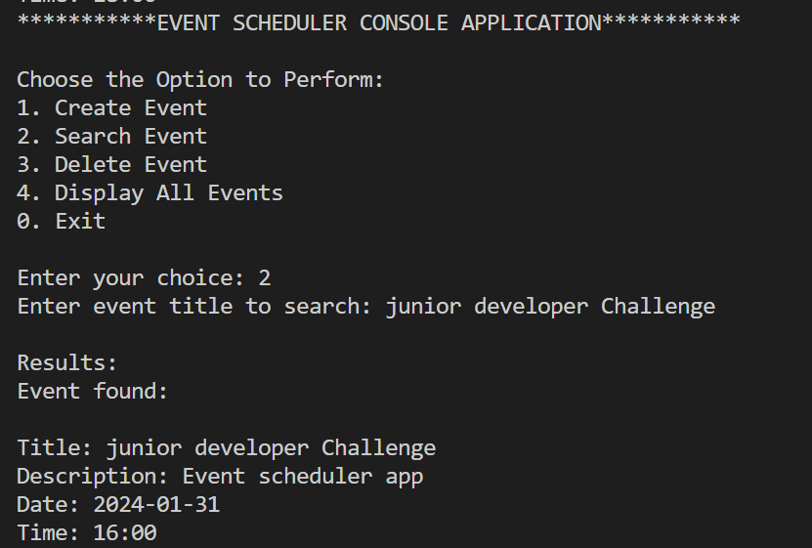
Usage and key features(cont…..):
Searching Event
Input:
The user is presented with a menu to choose an action: create, search, delete, display events, or exit.
The user selects "2" to search for an event.
The application requests the title of the event to search for.
Output:
After the user inputs the title, the application processes the search request.
If the event is found, the application displays detailed information about the event, confirming its existence.

Slide 9
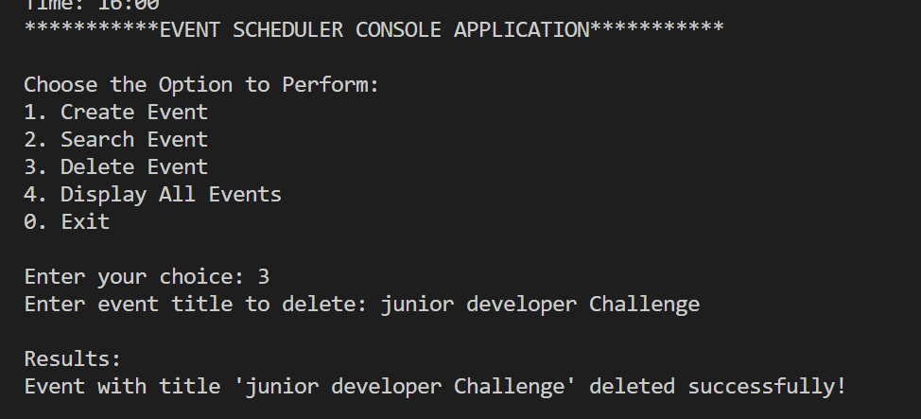
Usage and key features(cont…..):
Deleting Event
Input:
The user is given options to create, search, delete, display events, or exit in the application menu.
The user selects "3" to delete an event.
The application requests the title of the event to be deleted.
Output:
After the user provides the title, the application processes the deletion request.
If an event with the specified title exists, it is removed from the list, and the application confirms the successful deletion.

Slide 10
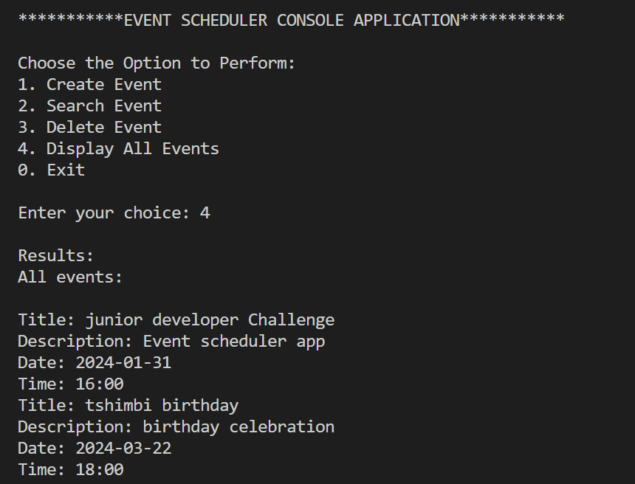
Usage and key features(cont…..):
Displaying All Events
Input:
The user is provided with options to create, search, delete, display events, or exit in the application menu.
The user selects "4" to display all events.
Output:
The application processes the request and retrieves a list of all events stored.
It then displays detailed information about each event, including title, description, date, and time.

Slide 11
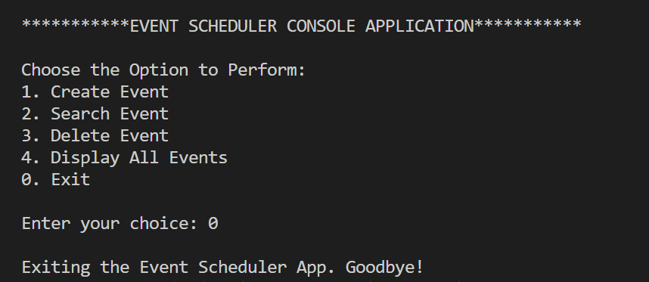
Usage and key features(cont…..):
Exiting the Application
Input:
The user is presented with options to create, search, delete, display events, or exit in the application menu.
The user selects "0" to exit the application.
Output:
The application processes the exit request.
It displays a farewell message, indicating that the Event Scheduler App is exiting, and terminates the program.

Slide 12

Conclusion
Summary: The Event Scheduler Console Application is a user-friendly tool for managing events through a simple command-line interface. Users can effortlessly create, search, delete, and display events. It offers an intuitive experience with in-memory storage, making it a lightweight solution for event organization without the need for complex tools.

Slide 13

Thank You
Tshimbiluni Theophillus Nedambale
Hugetshimbi@gmail.com
+27712565357

